Slide 1
PYTHON

Slide 2


Python is a widely used general-purpose, high level, object-oriented programming language.
Initially designed by Guido van Rossum in 1991
Developed by Python Software Foundation.
Emphasis on code readability and
Its syntax allows programmers to express concepts in fewer lines of code.

Slide 3
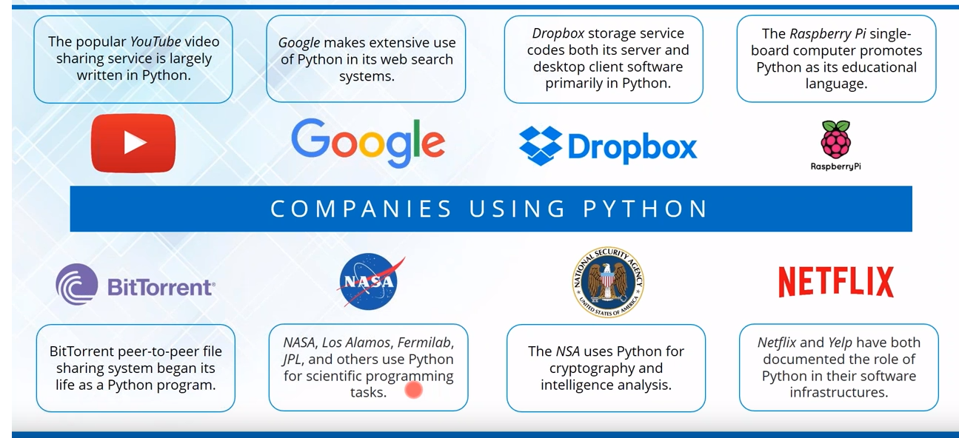
WHO USES PYTHON ?

Slide 4
General Editors and IDEs with Python Support
Eclipse + PyDev
Sublime Text
Atom
GNU Emacs
Vi / Vim
Visual Studio
Visual Studio Code

Slide 5
Python-Specific Editors and IDEs
PyCharm
Website: https://www.jetbrains.com/pycharm/
Spyder
Website: https://github.com/spyder-ide/spyder
Thonny
Website: http://thonny.org/

Slide 6
Installing Python on Windows [Pycharm IDE]

Slide 7
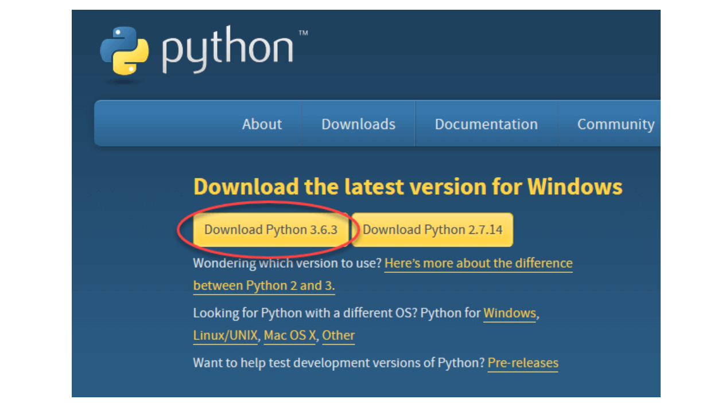
Step 1) To download and install Python visit the official website of Python http://www.python.org/downloads/ and choose your version. We have chosen Python version 3.6.3

Slide 8
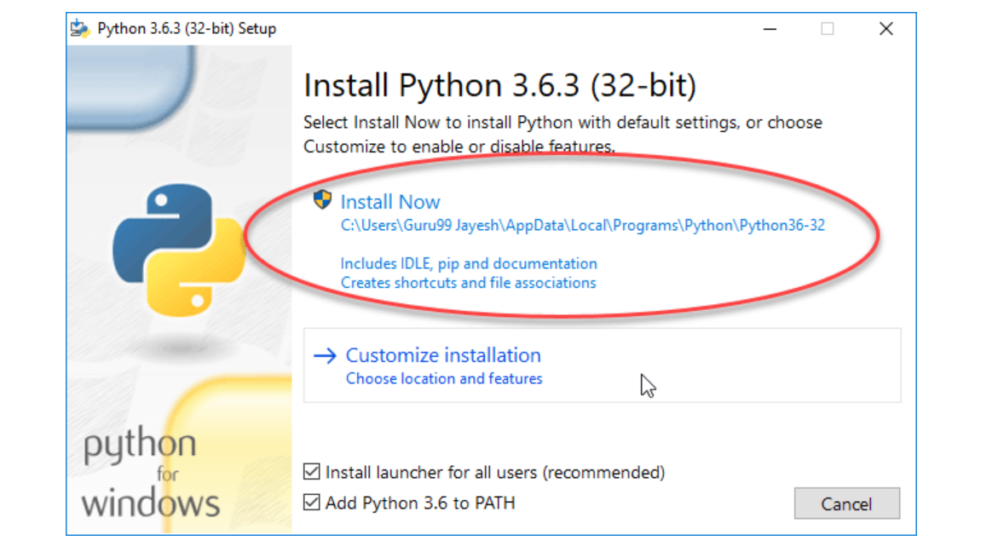
Step 2) Once the download is complete, run the exe for install Python. Now click on Install Now.

Slide 9
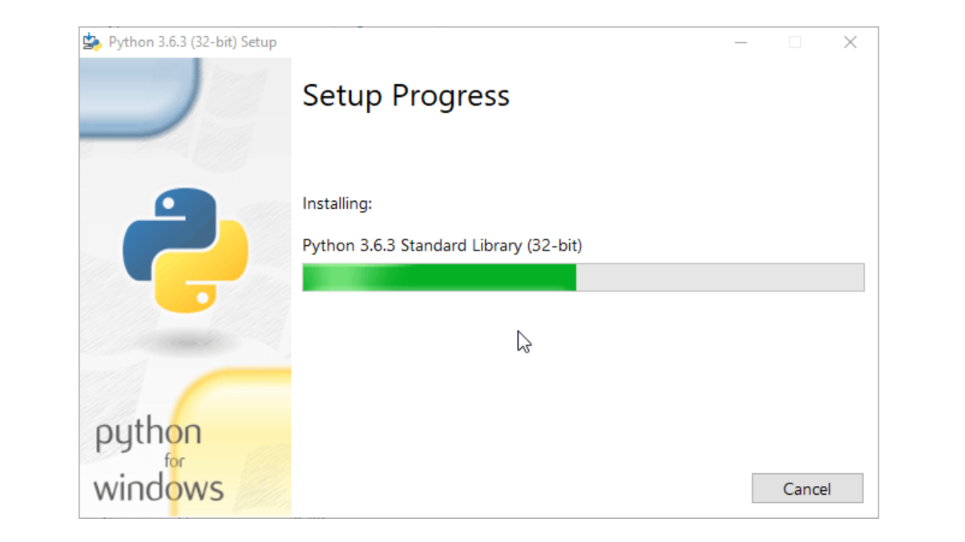
Step 3) You can see Python installing at this point.

Slide 10
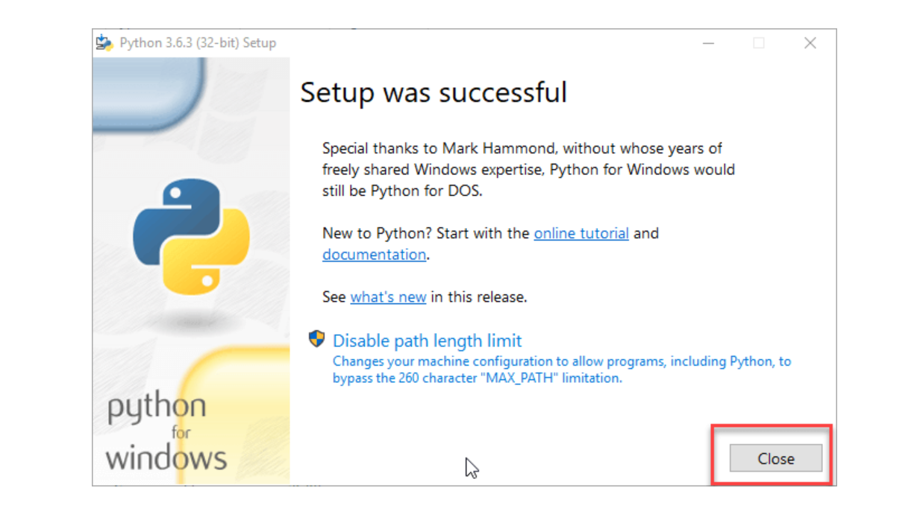
Step 4) When it finishes, you can see a screen that says the Setup was successful. Now click on "Close".

Slide 11
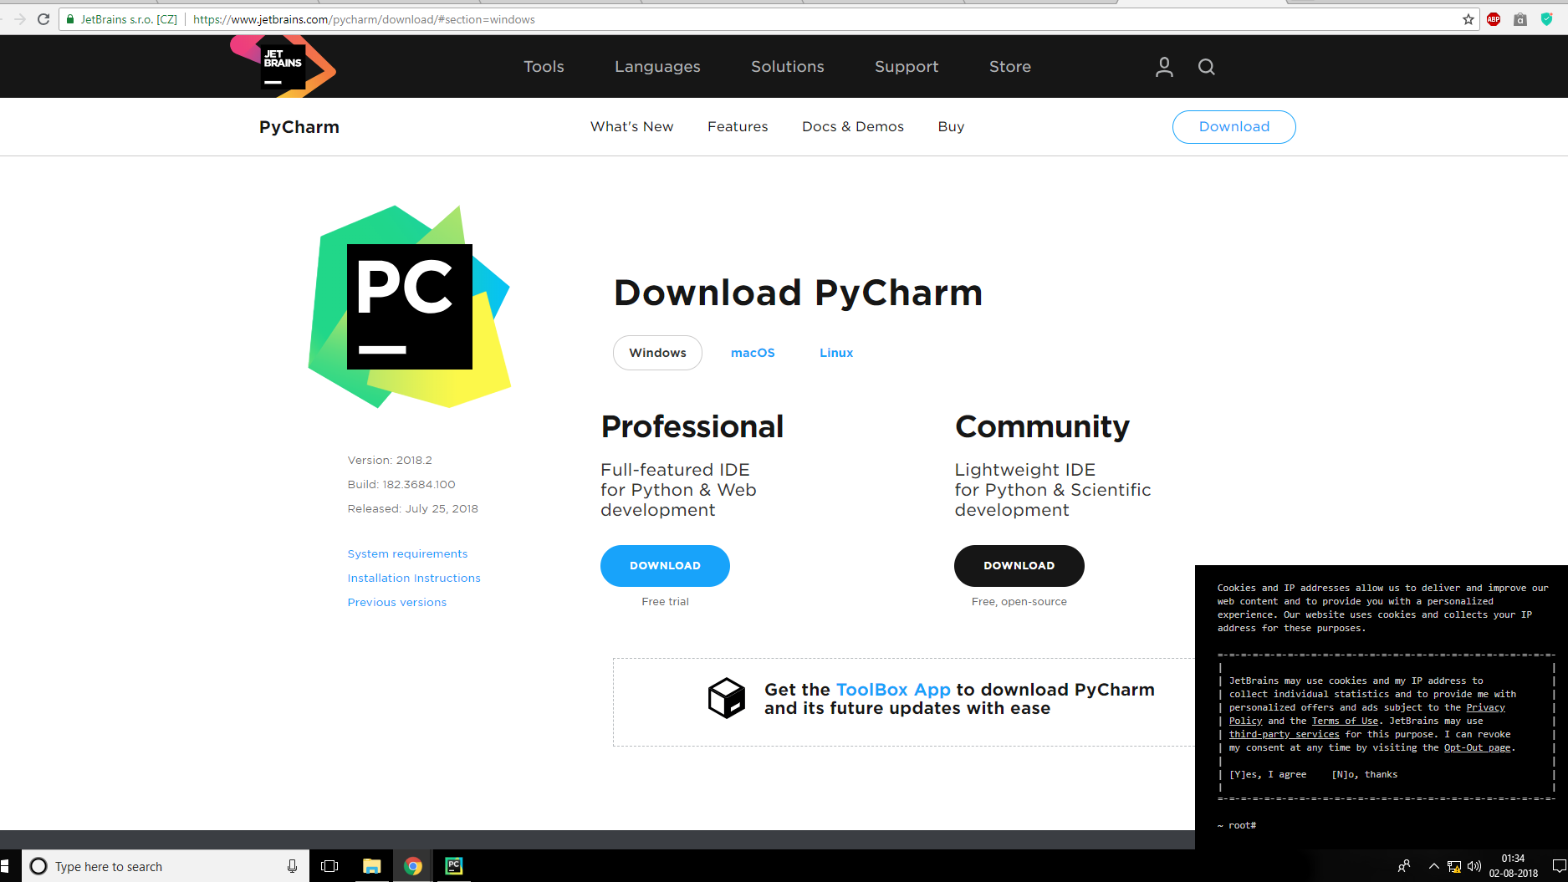
Step 5) To download PyCharm visit the website https://www.jetbrains.com/pycharm/download/ and Click the "DOWNLOAD" link under the Community Section.

Slide 12
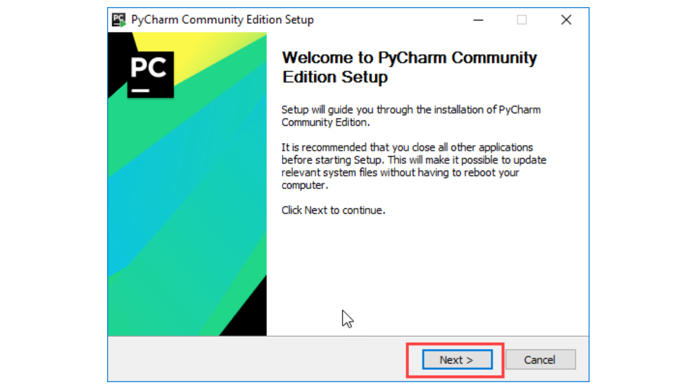
Step 6) Once the download is complete, run the exe for install PyCharm. The setup wizard should have started. Click “Next”.

Slide 13
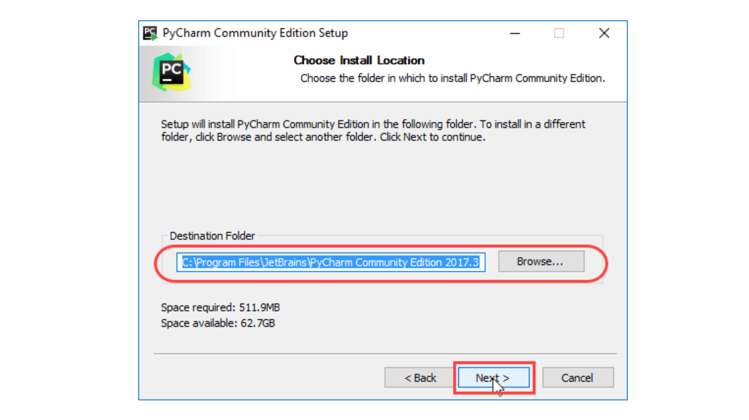
Step 7) On the next screen, Change the installation path if required. Click “Next”.

Slide 14
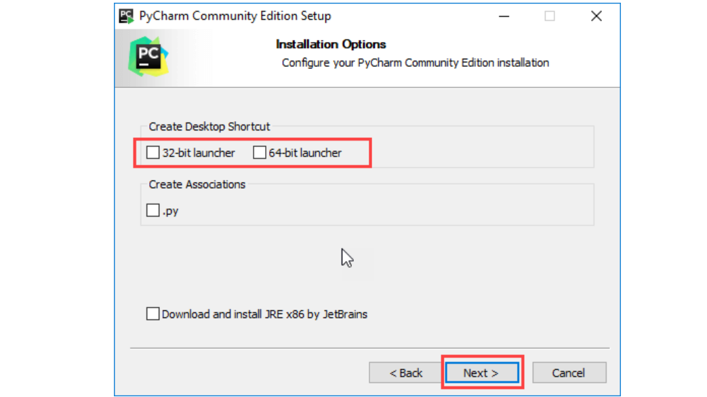
Step 8) On the next screen, you can create a desktop shortcut if you want and click on “Next”.

Slide 15
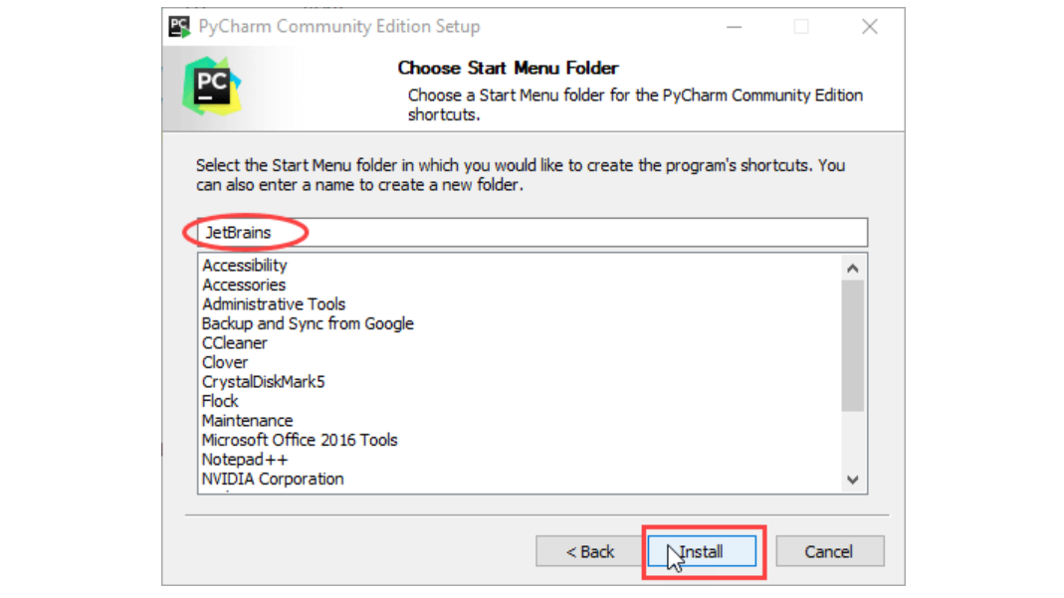
Step 9) Choose the start menu folder. Keep selected JetBrains and click on “Install”.

Slide 16
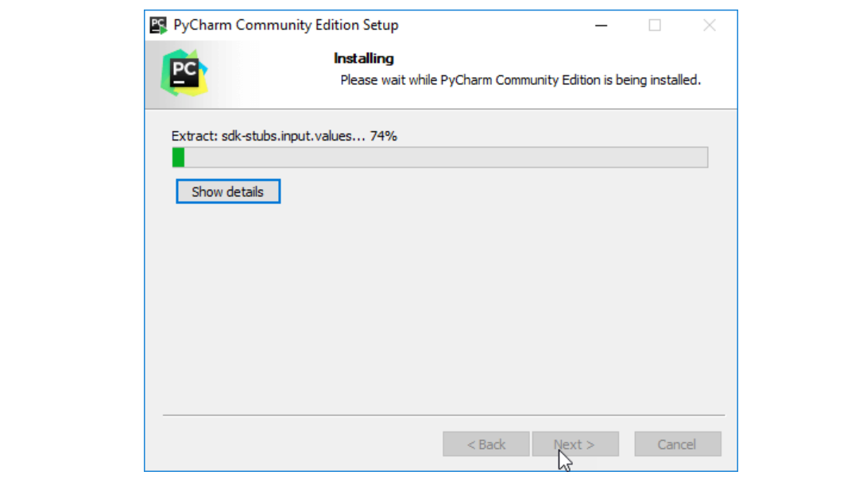
Step 10) Wait for the installation to finish.

Slide 17
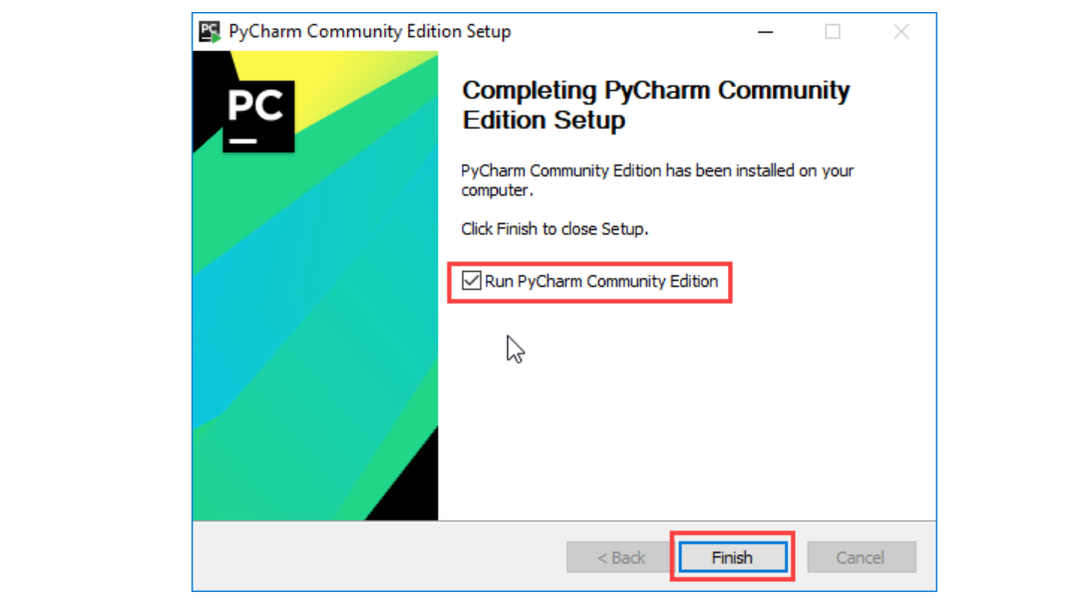
Step 11) Once installation finished, you should receive a message screen that PyCharm is installed. If you want to go ahead and run it, click the “Run PyCharm Community Edition” box first and click “Finish”.

Slide 18
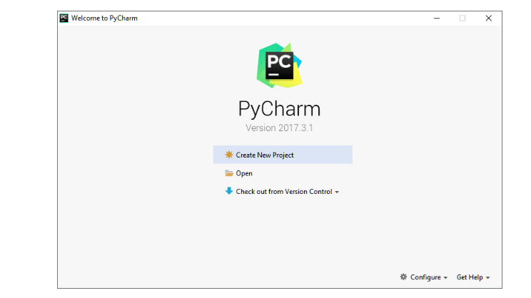
Step 12) After you click on "Finish," the Following screen will appear.

Slide 19
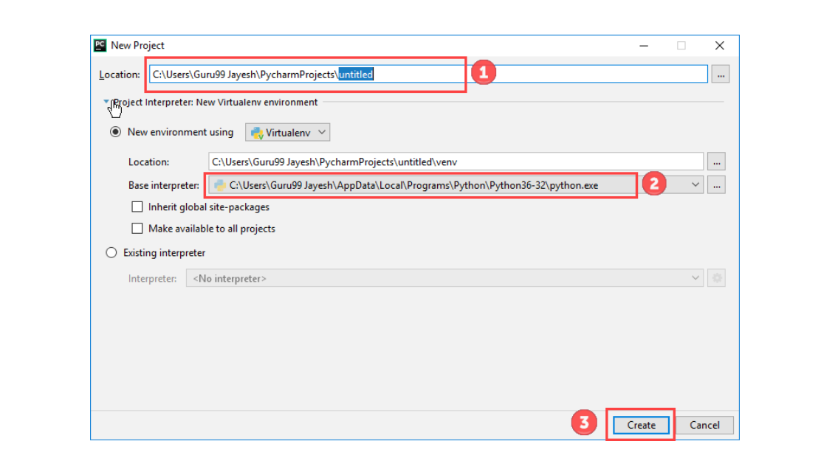
You can select the location where you want the project to be created. If you don’t want to change location than keep it as it is but at least change the name from “untitled” to something more meaningful, like “FirstProject”.
PyCharm should have found the Python interpreter you installed earlier.
Next Click the “Create” Button.

Slide 20
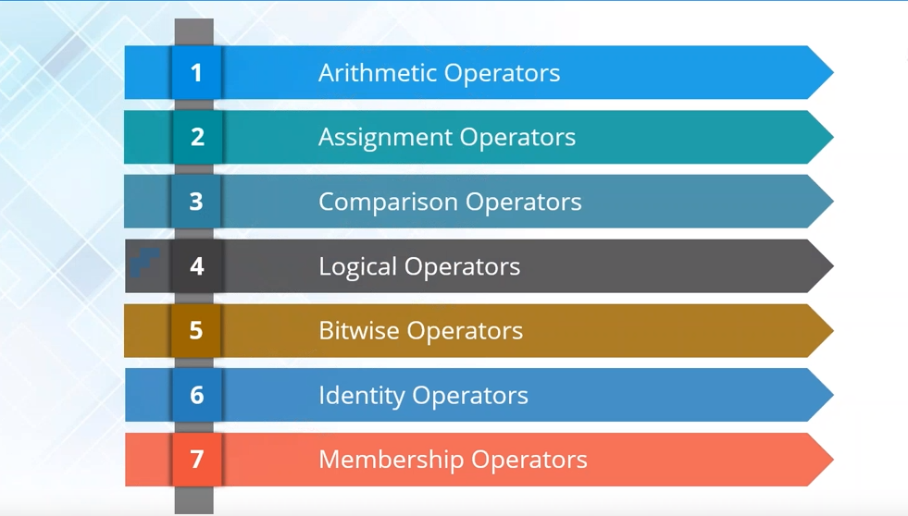

Slide 21
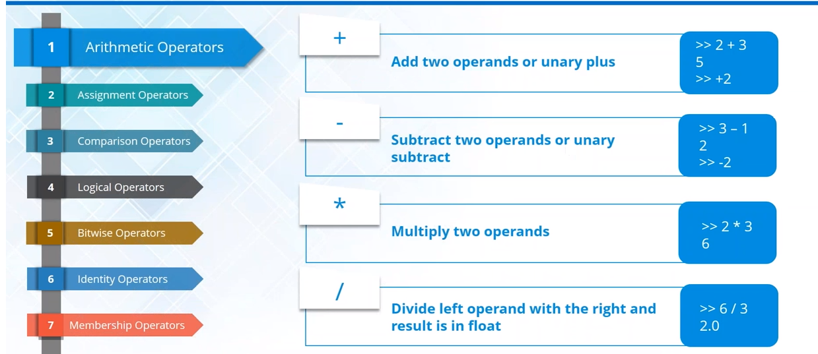

Slide 22
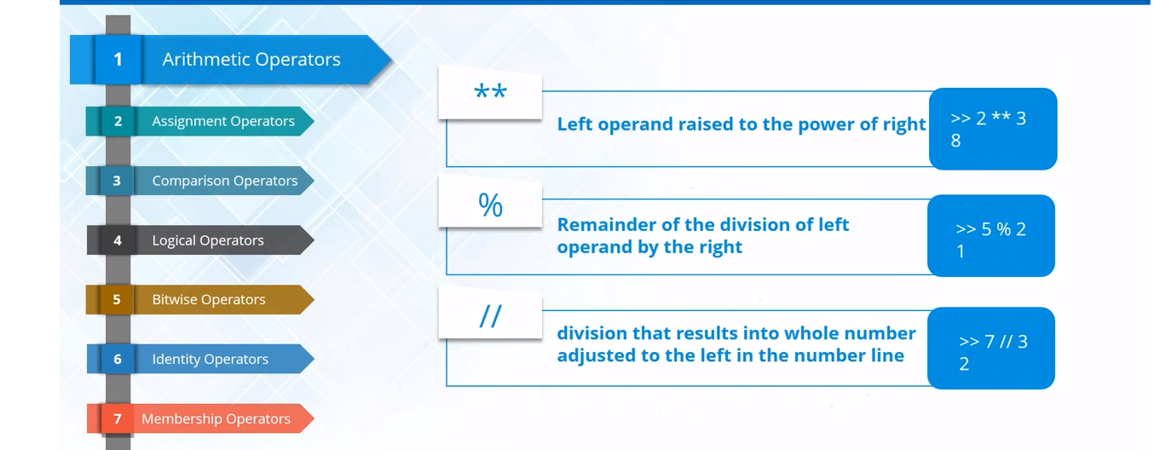

Slide 23
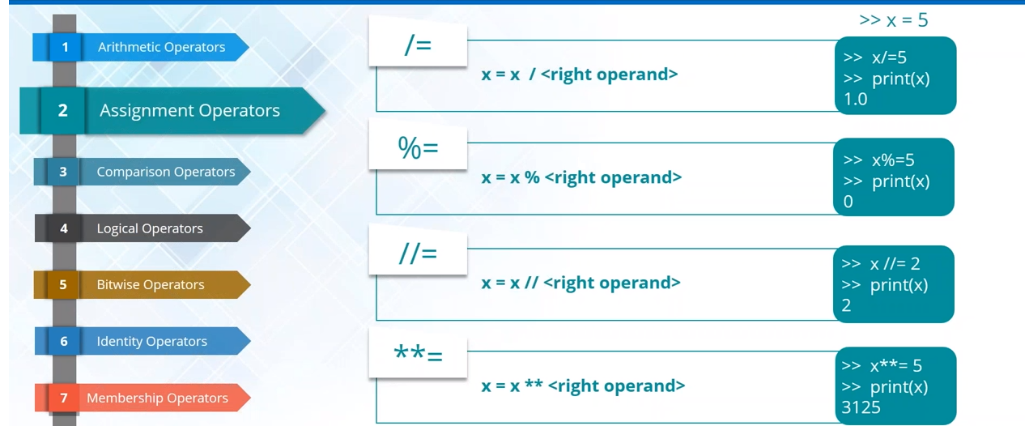

Slide 24
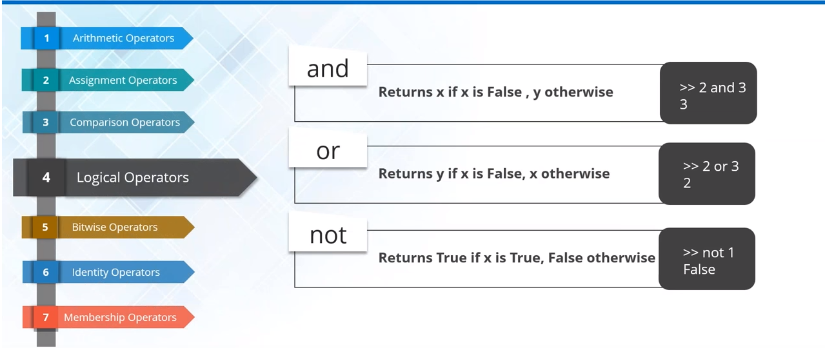

Slide 25
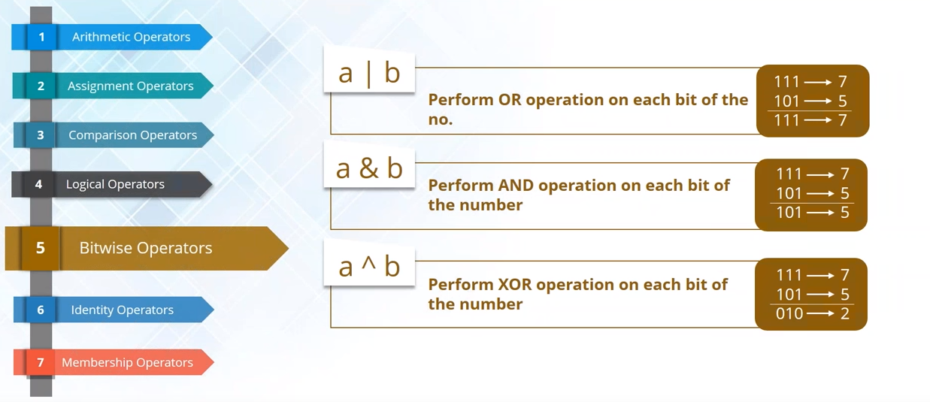

Slide 26
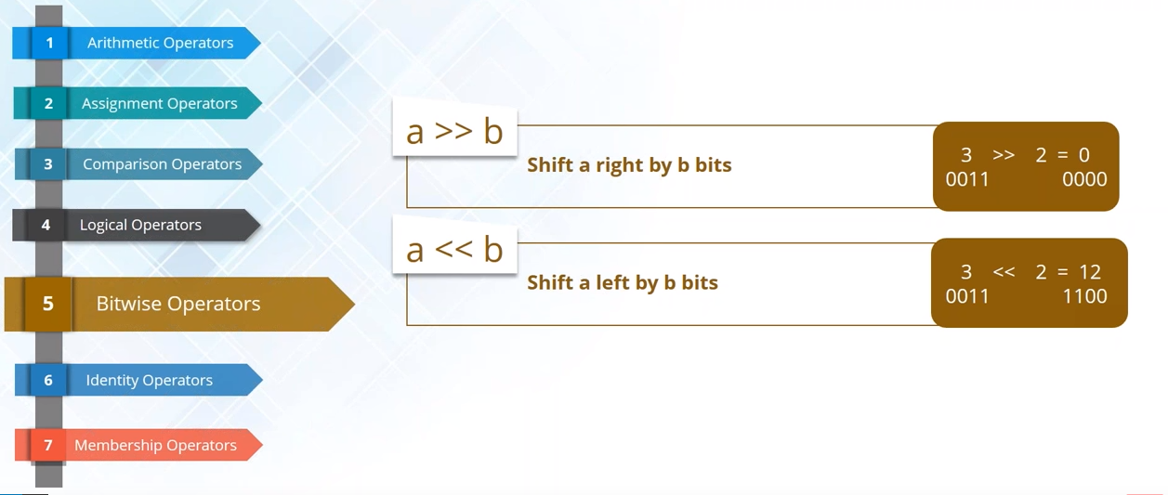

Slide 27
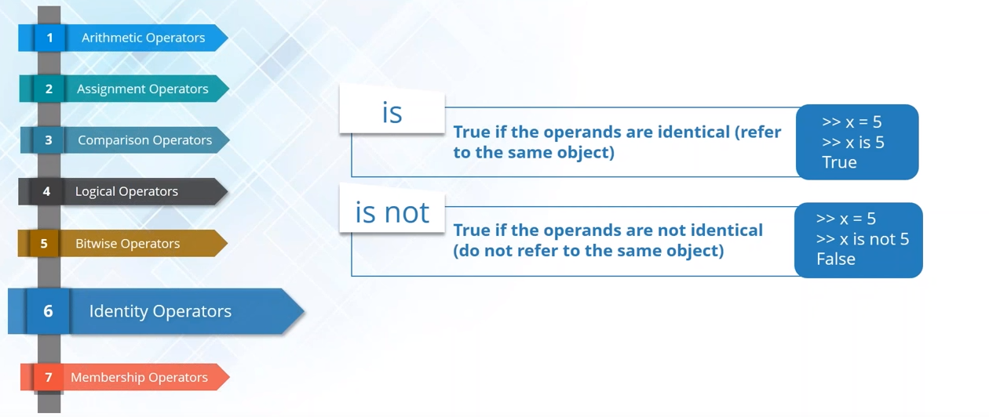

Slide 28
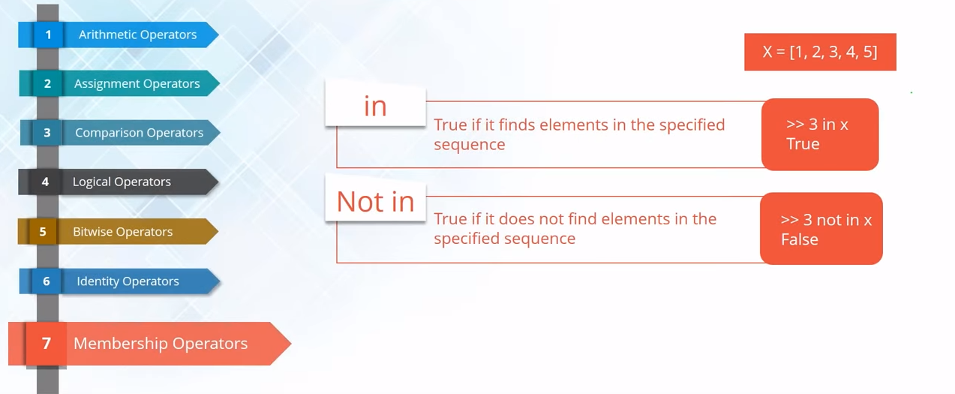

Slide 29
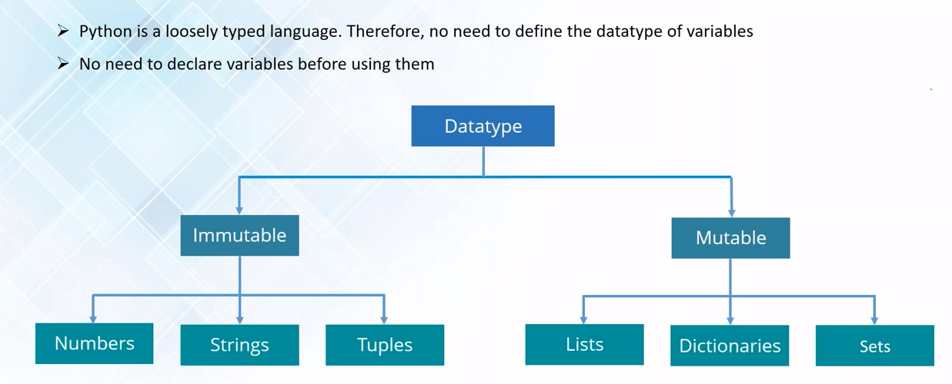

Slide 30
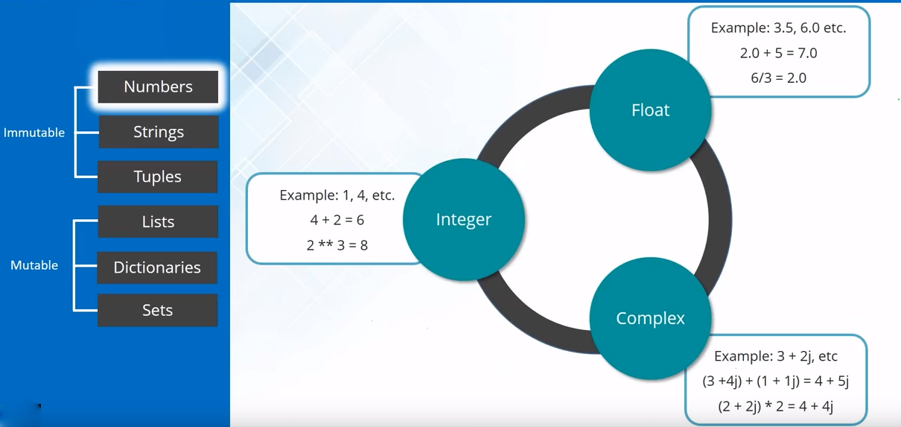

Slide 31
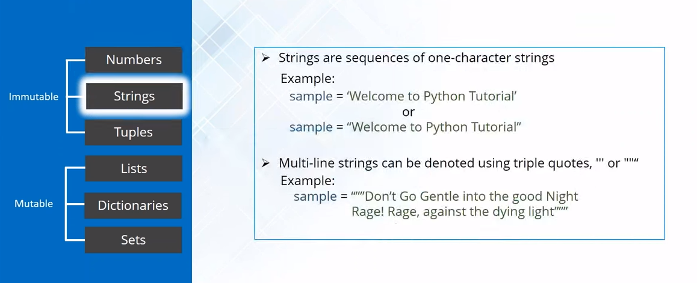

Slide 32
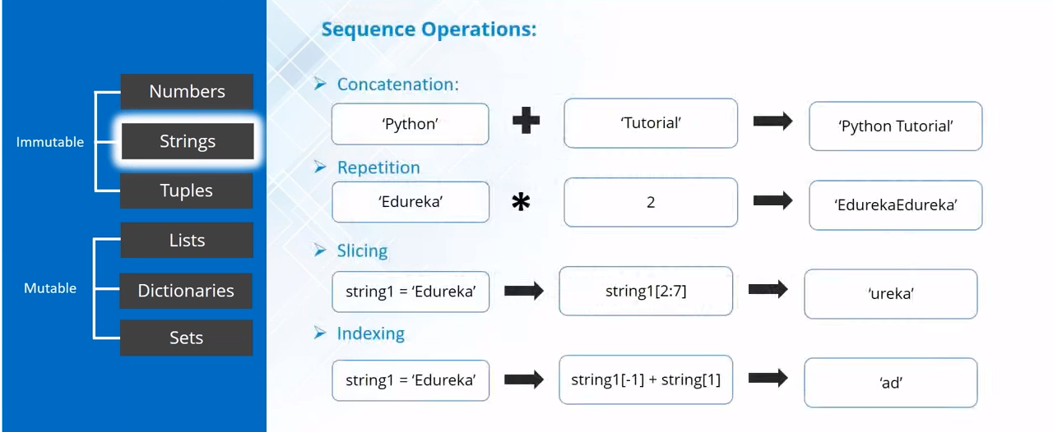

Slide 33
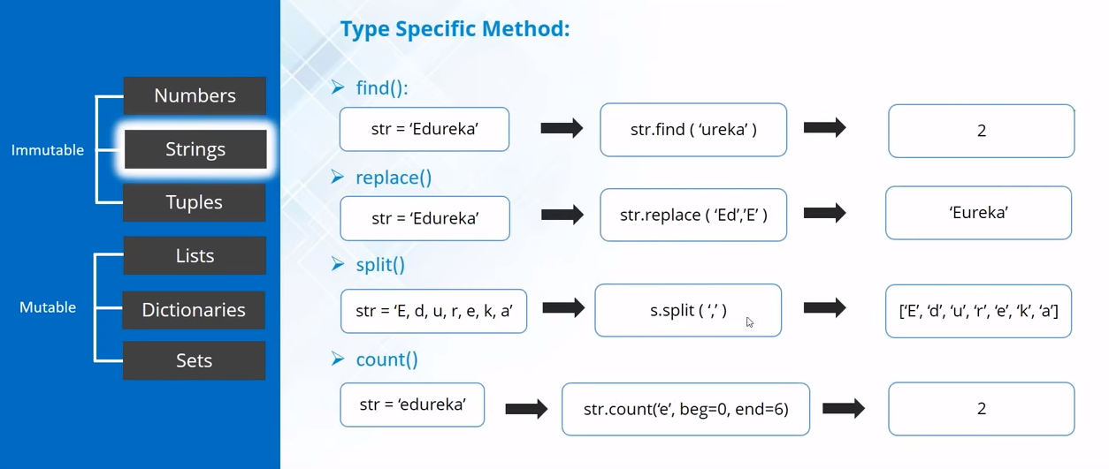

Slide 34
Thank you...

